Slide 1



z
Stock Data Visualization of Pharmaceutical Companies
Topic
Group 21 Presentation
Presented By– Mohammad Saqib Anasari
Notes:
Data Visualisation

Slide 2

ABOUT
Guided by: Dr Dootika Vats
Suchandra Sasmal - 221439
Debarghya Jana - 221306
Mrinmoy Saha - 221352
Mohammad Saqib Ansari - 221348
MTH208A ,DSLab-1

Slide 3



Content
Why Pharmaceutical Companies?
About the data
Terminologies related to the data
Questioned posed and Observation
R- Shinny App
Conclusion
OUTLINE

Slide 4
Why Pharmaceutical Companies
We have all witnessed the effects of the COVID 19 epidemic, which resulted in 6,596,100 fatalities worldwide ( as per WHO covid 19 website till 2nd November 2022 ).
The data contains various stock market related terminologies.
Buyers and sellers can trade equity shares of public firms in stock exchanges.
There are about 3000 drug companies in India .
The top 50 companies as per Forbes and Fortune does not contain any pharma sectors companies.

Slide 5
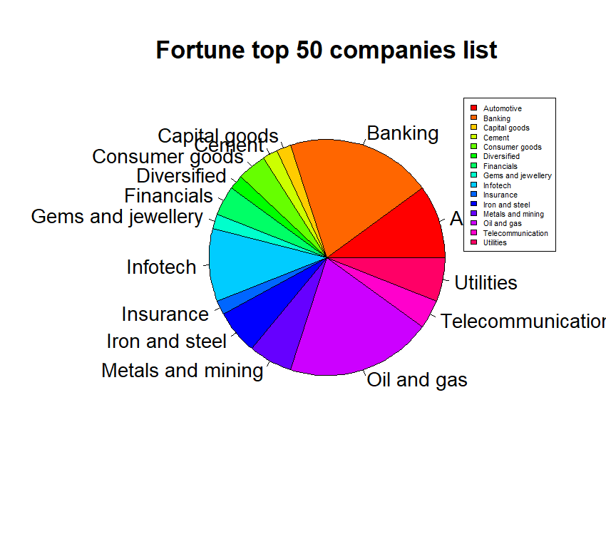
Distribution by sector
Forbes 22 list of 50 firms has 24% in banking, 10% in oil, 10% in infotech, and the rest are other.
(As Per https://en.wikipedia.org/wiki/List_of_largest_companies_in_India
Dated: 2, Nov 2022

Slide 6
About The Data
The data has been extracted from the list of 95 companies from the first 4 pages website moneyworks4me.
It contains 95 companies with 31 variables related to each.
Everyday data was changing we had to extract the whole data in one We also added 2 columns from outside the website.
Like finding year of establishment and headquarters for all 95 companies was challenging.
Link:” https://www.moneyworks4me.com/best-index/bse-stocks/top-pharma-companies-in-india/page/1” ( Date and Time: 10 Oct 2022 , 2:00pm)

Slide 7
Terminologies and Description Includes
Name : the brand of the business or the company name.
Headquarter: state where the business is located
Year : The year in which the firm was founded.
Market Capitalization : The total worth of all a company's stock shares is referred to as market cap, also known as market capitalization.
Type Of Market Cap : Market capitalization is traditionally divided into three categories: large-cap, mid-cap, and small-cap.

Slide 8

1eii
“Large Cap Companies have market capitalisation of 20 thousand Crore and more .”
“Mid Cap Companies have market capitalisation between 5 thousand crore to 20 thousand crore. ”
“Small Cap Companies have market capitalisation of less than 5 thousand crore .”
TYPE OF MARKRT CAPITALISATION
Large Cap>= 20,000 Cr
20,000 Cr >Mid Cap> 5000 Cr
5,000 Cr> Small cap
Notes:
$$\text{for} \text{the} \text{purpose} \text{of} \text{comparing} their performances and finally to arrive$$
at one estimator of $θ$, using these sampling distributions , which is more optimal in some desirable sense .

Slide 9
CMP: It refers to the current market price of the stock.
CMP % Change: It indicates the percentage change in price since the previous market day.
Latest PE: PE stands for Price to earning ratio. It is a measure to compare stock in the same industry whether its expensive or cheep compare to peers.
Price Per Share
Earning Per Share
PE Ratio=

Slide 10
Five year profit growth %: The yearly compound growth rate of revenues over the previous five years is known as the "Five Year Revenue Growth Rate."
ROCE (Return on Capital employed): It is a financial measure that may be used to evaluate the profitability and capital efficiency of an organization. In other words, this ratio can be used to determine how effectively a business is turning a profit from the capital it uses.
ROCE=
EBIT
Capital Employed
EBIT=Earnings before interest and tax
Capital Employed=Total assets − Current liabilities​
10

Slide 11
Annual Revenue/ Sales: The total amount of money a business brings in each year from the sale of goods, services, assets, or capital is known as annual revenue. It does not take any of costs into consideration. Because of this, income statements frequently refer to revenue as "sales.“
TTM Sales: Trailing 12-month or TTM sales refers to the past 12 consecutive months of the company’s performance data using to figure out the sales of the company
Trailing twelve months data is used to remove seasonality from the data . It shows company trajectory and removes away inconsistencies. Similarly TTM PE, TTM BVPS .

Slide 12
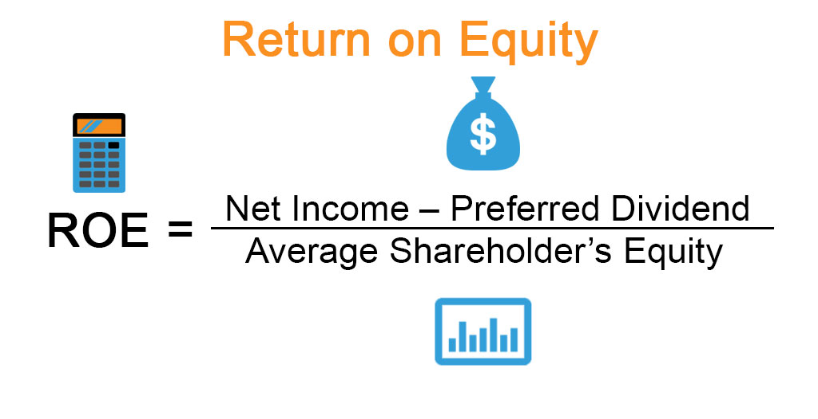
Return on Equity(ROE)
Birnbaum (1962) was first to outline the principle, which is defined as: “In the presence of a sufficient statistic t(x) with statistical model E’, the inferences concerning θ from E and x should be the same as from E’ and t(x)” ~ (Fraser, 1962)ghjghj
A metric of financial performance known as return on equity (ROE) is obtained by dividing net income by shareholders' equity. ROE is referred to as the return on net assets since shareholders' equity is determined by subtracting a company's debt from its assets.
Return on Equity

Slide 13
Question Posed
What is the trajectory of sales since 2013 to 2022?
To compare the companies sales performance during 2013 to 2022.
Which market capitalization types of businesses are frequent?
What percentage of Pharma companies came into existence after Independence?
Which state has the highest concentration of businesses?

Slide 14



Shinny App- Its feature
Analysis of Stock Variables
On the basis of financial measure like P/E ratio ,ROCE, P/B ratio, sales etc, showing histogram,
boxplot and summary .
Pie chart
Shows the pie chart of market capitalisation.
Yearly Sales Analysis
Showing overlap frequency polygon and histogram of companies sales.
Comparison of Sales for different companies
Showing the sales trajectory of any number of companies.
Shinny app

Slide 15
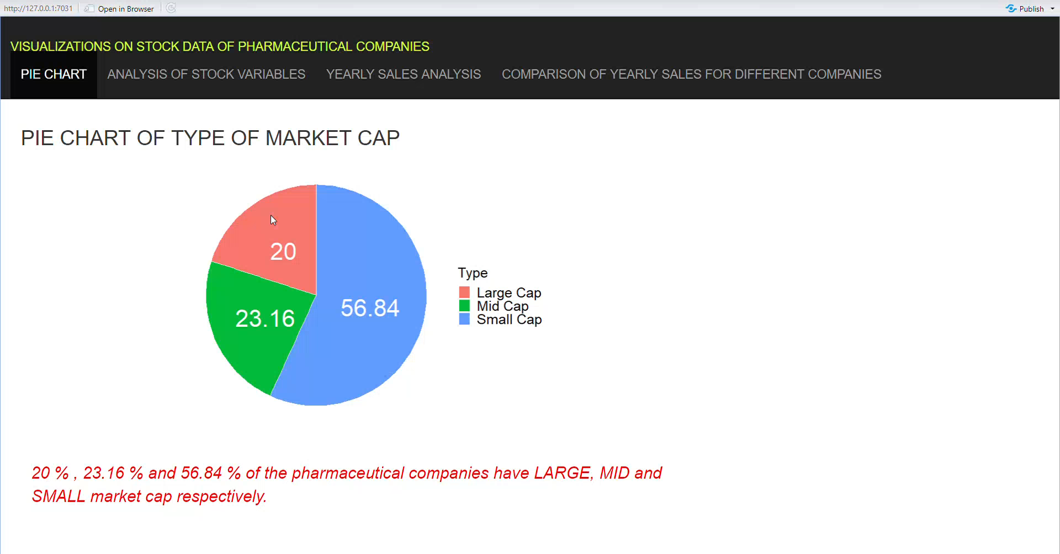

Slide 16
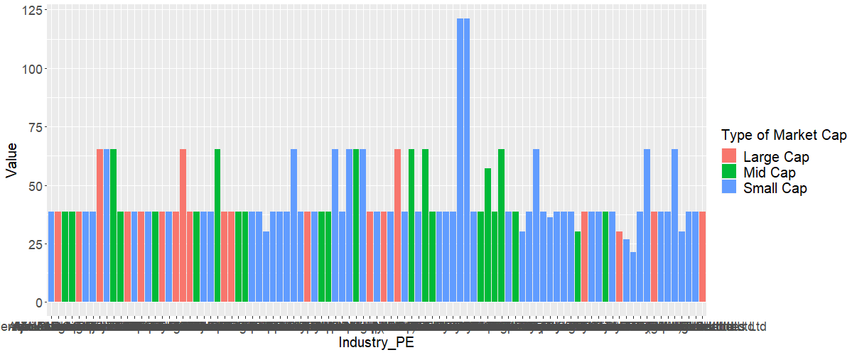
Comparison of Industry PE
Company having highest value of Industry PE is Novartis India Ltd . Company having lowest value of Industry_PE is Tarsons Products Ltd .

Slide 17
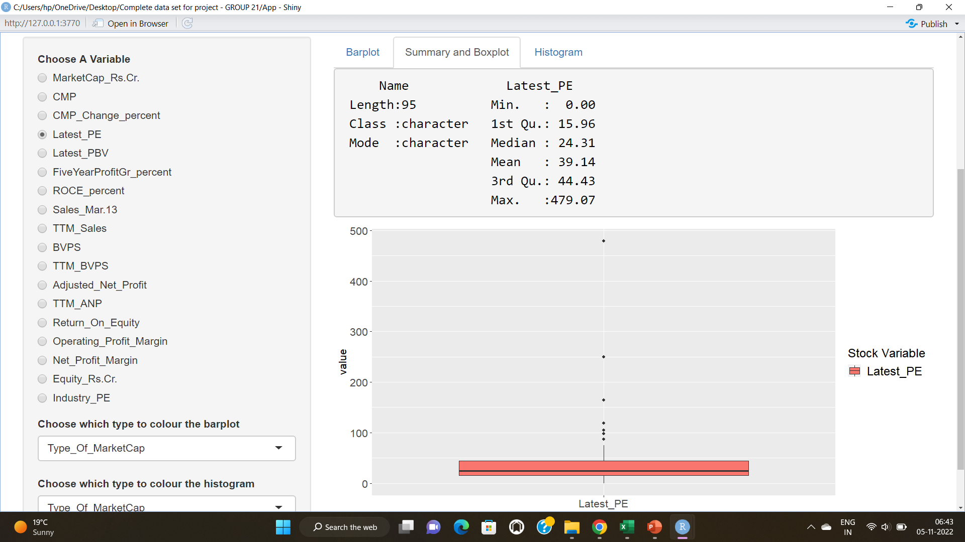

Slide 18
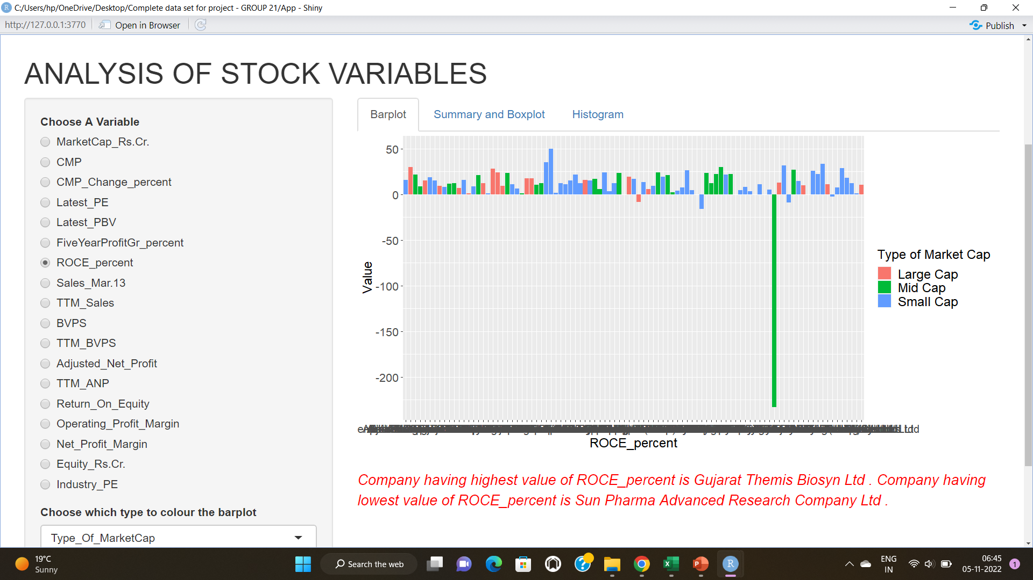

Slide 19
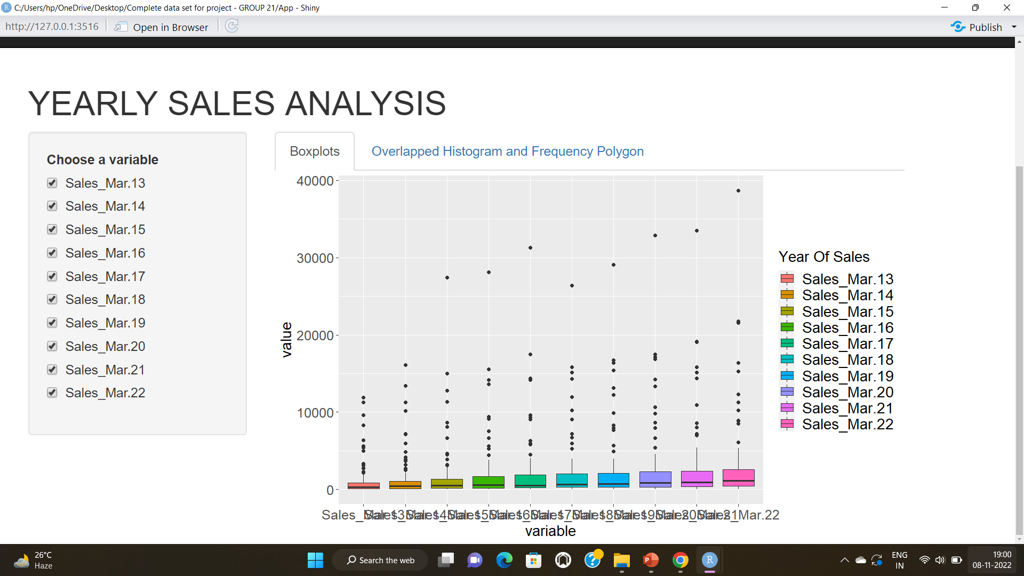

Slide 20
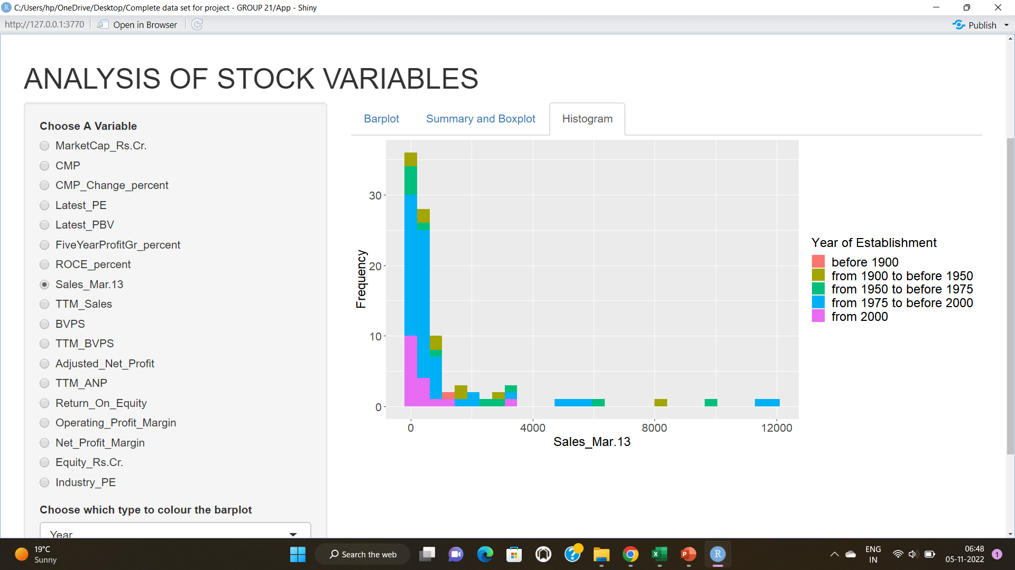

Slide 21
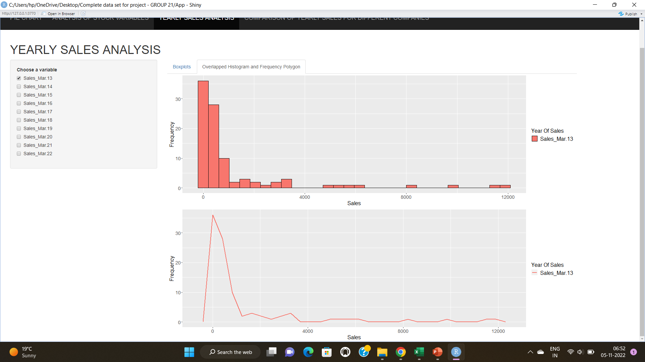

Slide 22
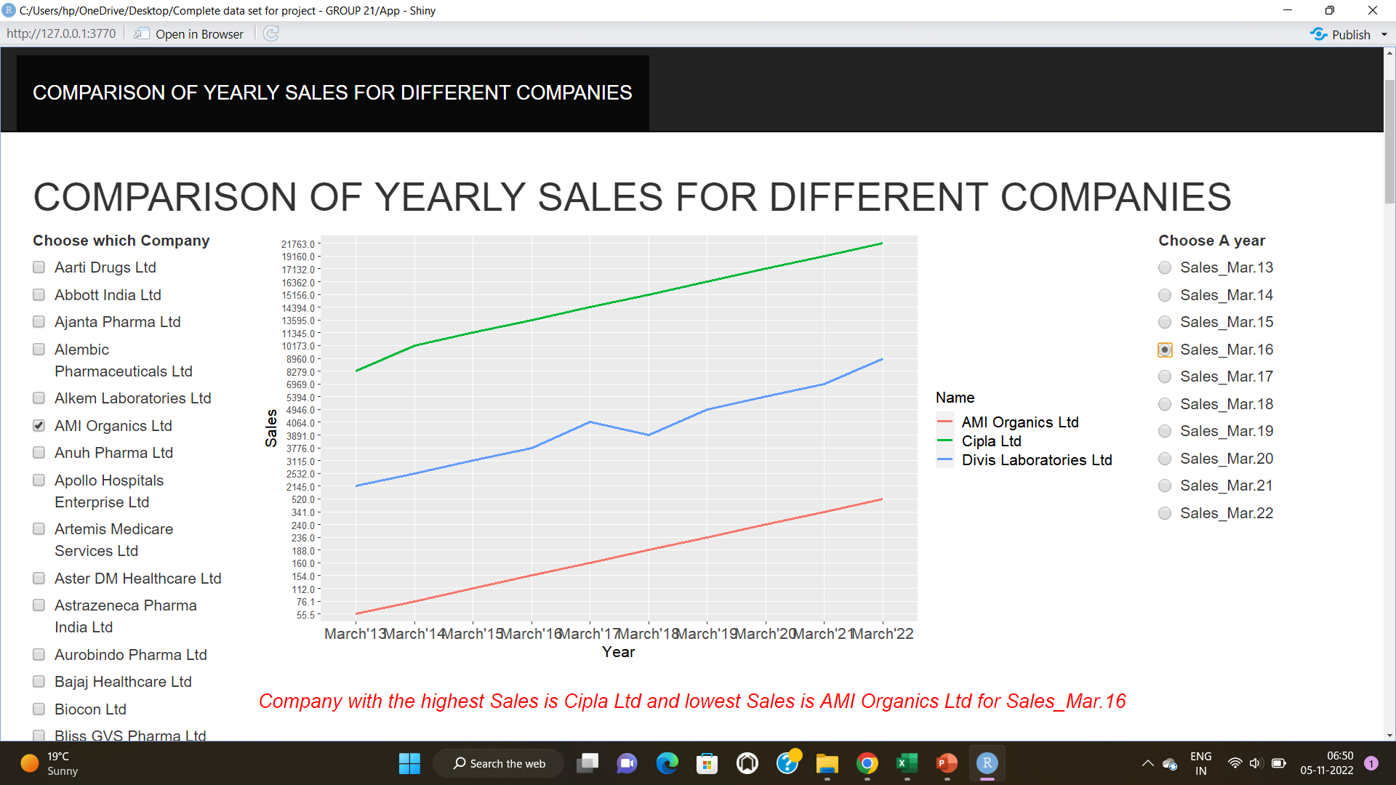

Slide 23
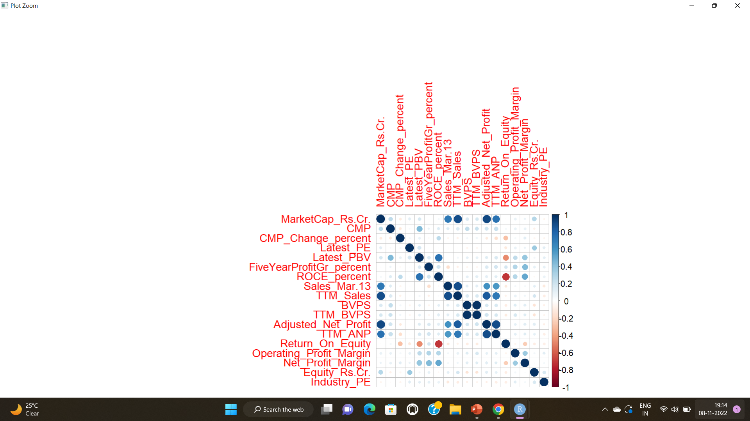

Slide 24
Further Questions
that a statistic T is a sufficient statistic for θ by definition, we must verify that for any fixed values of x, the conditional distribution X|T(X) = T(x) does not depend on θ. This may not be easy but at least we can try. But how do we find the form of T? By guessing a statistic T that might be sufficient and computing the conditional distribution of X|T = t? For families of populations having pdfs or pmfs, a simple way of finding sufficient statistics is to use the following factorization theorem.
Which companies giving better returns to their investors?
Which companies showed the best growth in last five years?
To compare financial measures to analyze the company performance.
Question Posed

Slide 25
Conclusion
There is tremendous increase in the number of Pharma Companies since independence.
The majority of companies headquarter are in Mumbai.
The most of companies have shown upward trend and few went down during the span of 2013 to 2022.
The small cap companies are more in numbers.
Small cap companies have potential to give better returns with a little greater risk .
Conclusion

Slide 26
REFERENCES
1) Nifty Pharma Stocks - Nifty Pharma Index Companies | MoneyWorks4me.com(Data)
2) https://www.investopedia.com/(Terminologies)
3)https://en.wikipedia.org/wiki/List_of_largest_companies_in_India(list of 100 companies)
4) educba.com (Pictures)
5) https://shiny.rstudio.com/tutorial/written-tutorial/lesson1/
6) https://shiny.rstudio.com/gallery/#demos
REFERENCES

Slide 27
THANK YOU !!

